Slide 1

Applying for Adolescent Medicine Fellowship 2024
Student-Trainee Council
Executive Committee
2024

Slide 2
Presentation Outline:
STEP 1: Identify Fellowship Requirements
STEP 2: Research Fellowship Programs
STEP 3: Application Process
STEP 4: Virtual Interviews
STEP 5: Submit Rank List

Slide 3
STEP 1: Eligibility Requirements
You must complete one of the following ACGME-accredited residency programs:
  Pediatrics
  Internal Medicine
  Combined Internal Medicine-Pediatrics
  Family Medicine
Notes:
https://www.acgme.org/Portals/0/PFAssets/ProgramRequirements/321_AdolescentMedicine_2019.pdf?ver=2019-08-01-123255-437
STEP 1
Eligibility: CLARIFY HERE THAT YOU CAN BE IN THE PROCESS OF COMPLETING A RESIDENCY PROGRAM/IN YOUR FINAL YEAR OF RESIDENCY AT TIME OF APPLICATION
In order for you to be able to apply for an Adolescent Medicine position, you should successfully completed a ACGME-accredited residency program, an AOA-approved residency program, program with ACGME International (ACGME-I) Advanced Specialty Accreditation, Royal College of Physicians and Surgeons of Canada (RCPSC)-accredited or College of Family Physicians of Canada (CFPC)-accredited residency program located in Canada in one of the following area:
Pediatrics
Family Medicine
Internal Medicine
Combined internal medicine-pediatrics
Exceptions (read only if international trainee present during presentation) PLEASE CONTACT PROGRAMS DIRECTLY
An ACGME-accredited fellowship program may accept an exceptionally qualified international graduate applicant who does not satisfy the eligibility requirements listed in III.A.1., but who does meet all of the following additional qualifications and conditions:
Evaluation by the program director and fellowship selection committee of the applicant’s suitability to enter the program, based on prior training and review of the summative evaluations of training in the core specialty
Review and approval of the applicant’s exceptional qualifications by the GMEC
Verification of Educational Commission for Foreign Medical Graduates (ECFMG) certification (this means passing Step 1, Step 2 CK and Step 2 CS)
Applicants accepted through this exception must have an evaluation of their performance by the Clinical Competency Committee within 12 weeks of matriculation

Slide 4
STEP 2: Researching Fellowship Programs
Use the ERAS website to learn about participating and non-participating programs
https://services.aamc.org/eras/erasstats/par/display.cfm?NAV_ROW=PAR&SPEC_CD=321
If in doubt, contact the program directly (look at program website)
Notes:
Source: https://services.aamc.org/eras/erasstats/par/display.cfm?NAV_ROW=PAR&SPEC_CD=321
STEP 1: Explore your options, review all fellowship programs (keep an open mind, start broad early and narrow later).
You can find information about participating vs non-participating programs through the ERAS Website

Slide 5
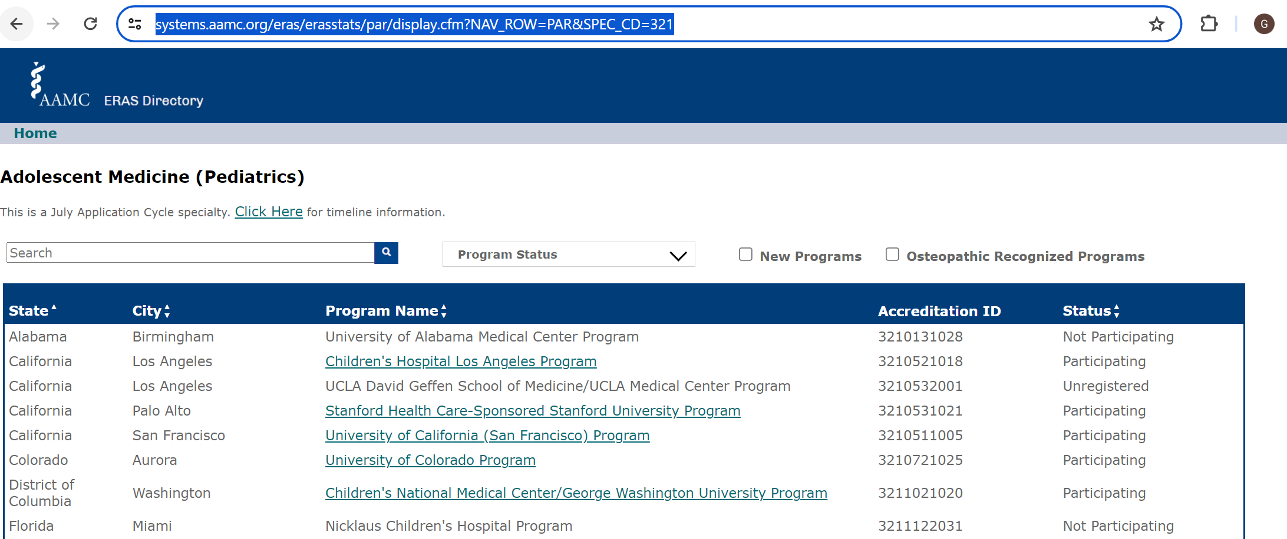
https://services.aamc.org/eras/erasstats/par/display.cfm?NAV_ROW=PAR&SPEC_CD=321
Notes:
Talk about differences in status (not participating, unregistered, participating) and what those mean?
Maybe mention that applicants should look at the individual websites of each program they are applying to in order to ensuring they are meeting application requirements?

Slide 6
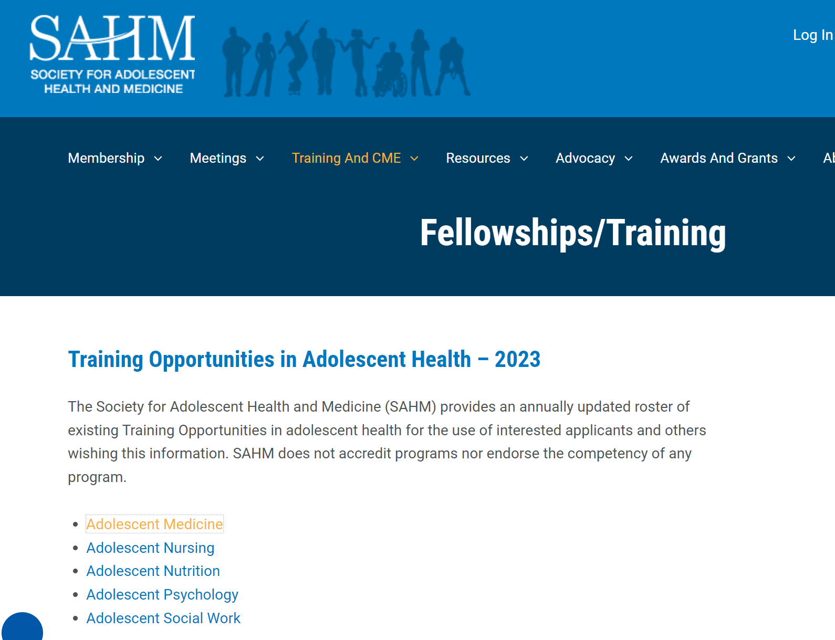
SAHM website PDF is NOT yet up to date
https://adolescenthealth.org/training-and-cme/fellowships-training/
Notes:
You can also find specific information about each program and contact information on the SAHM website

Slide 7
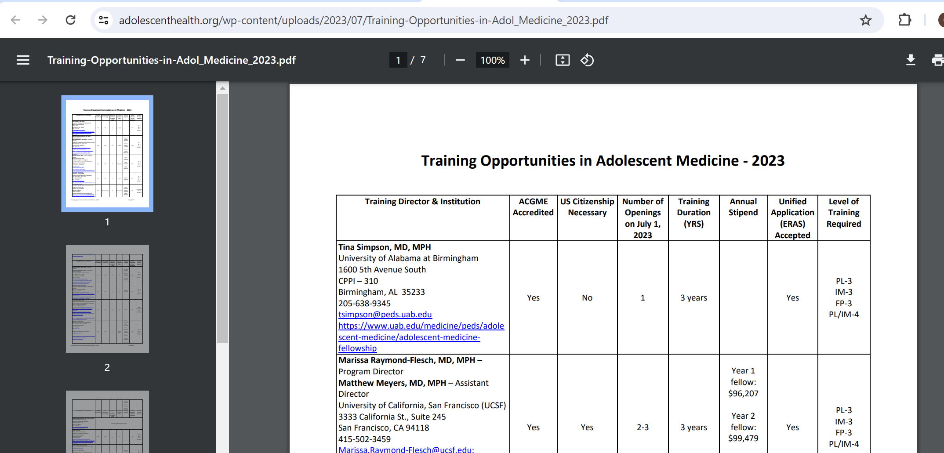
SAHM website PDF is NOT yet up to date
https://adolescenthealth.org/training-and-cme/fellowships-training/

Slide 8
Opportunities To Consider During Fellowship
Advanced degrees & certifications
LEAH programs
Specific Interests
Primary vs specialty care
Inpatient (primary service or consult) vs outpatient time
Research
Notes:
Advance degrees
Master degree opportunities are offered my some program these include MPH, MSc, Med
Funding for these degree vary from program to program so be sure to discuss this during your interview!
Other important questions specific to these degree includes protected vs unprotected time, online vs traditional classrooms
In other programs obtaining a masters degree is embedded in the fellowship training and thus is mandatory
LEAH programs (https://mchb.hrsa.gov/training/projects.asp)
LEAH-Leadership in Education and Adolescent Health
Goal: Prepares professionals from a variety of health care disciplines to be leaders in clinical care, research, public health policy, and advocacy as it relates to adolescent health.
There are currently 8 active LEAH programs: Boston Children’s Hospital, Children’s Hospital of Los Angeles, Children’s Hospital of Philadelphia, University of Alabama at Birmingham, University of California-San Francisco, University of Minnesota, University of Washington
International rotations, more/less training in certain areas (e.g. substance use disorder management, sports medicine, reproductive health)
If you are interested in having a primary care clinic vs just working in specialty adolescent care
How much inpatient time/experience you want
Research grants-Internal and internal grant opportunities based on each program
AAP CATCH grants (https://www.aap.org/en-us/advocacy-and-policy/aap-health-initiatives/commpeds/catch/Pages/CATCH-Grants.aspx)
. Grants up to $10,000 are awarded annually on a competitive basis to pediatricians who plan to build broad-based community partnerships to address unmet child health needs.

Slide 9
Masters Degrees/certifications
  Offered by some but not all programs
    MPH, MSc, MEd
  In some places, mandatory or highly encouraged
  Funding varies
  Protected vs unprotected time
  Online vs traditional classrooms

Slide 10
Specific Interests
All programs cover the same material per ACGME, but depending on program may have more or less experiences
  External rotations vs. faculty who incorporate into their practice
Examples:
  Addiction medicine
    Adult vs. adolescent substance use rotations
  Juvenile Justice
    Gang violence, survivors of trafficking, neurodiverse youth
  Obesity medicine
    Multidisciplinary clinics, medication management
  In-patient and outpatient psychiatry rotations
  LARC placement
  Gender-affirming care
    Due to state laws, some only have adolescents 18+

Slide 11
Research
Per ACGME, need at least 1 scholarly requirement
Grant money (internal and external)
Statistician access
Other researchers in your area of interest
Protected time

Slide 12
LEAH Programs
Leadership in Education and Adolescent Health
  Government grant funded educational programs
  https://mchb.hrsa.gov/training/projects.asp
  Goal: Prepares professionals from a variety of health care disciplines to be leaders in clinical care, research, public health policy, and advocacy as it relates to adolescent health.
  Specific educational activities vary from program to program
  9 active LEAH programs:
    Texas Children’s/Baylor College of Medicine, Boston Children’s Hospital, Children’s Hospital of Los Angeles, Children’s Hospital of Philadelphia, Indiana University , University of Alabama at Birmingham University of California-San Francisco, University of Minnesota, University of Washington

Slide 13
Step 3: Application
Helpful websites
https://students-residents.aamc.org/applying-fellowships-eras/applying-fellowships-eras
https://students-residents.aamc.org/eras-tools-and-worksheets-fellowship-applicants/eras-tools-and-worksheets-fellowship-applicants
Helpful Checklist
https://students-residents.aamc.org/media/9736/download

Slide 14
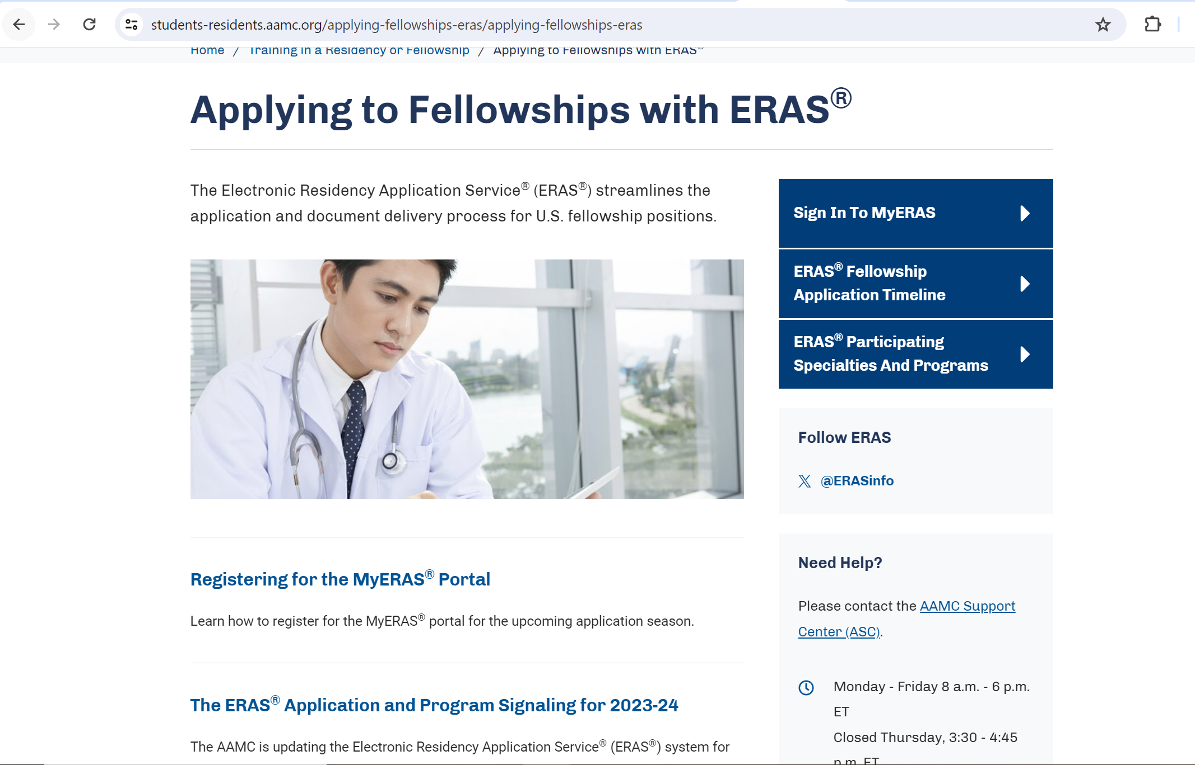

Slide 15
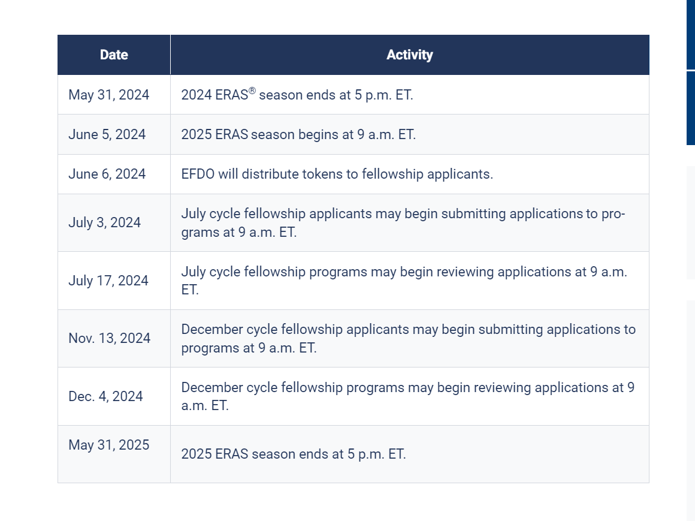
Timeline
https://students-residents.aamc.org/eras-tools-and-worksheets-fellowship-applicants/2025-eras-fellowship-application-timeline
Notes:
https://students-residents.aamc.org/eras-tools-and-worksheets-fellowship-applicants/2025-eras-fellowship-application-timeline

Slide 16
Step 3: Application
Register on MyERAS
https://myeras.aamc.org/myeras-web/
Register AAMC account
Register ERAS token to the AAMC account
Register for NRMP Match Service
https://www.nrmp.org/fellowship-applicants/participating-fellowships/medicine-and-pediatric-specialties-match/

Slide 17
STEP 3: Application
Purchase ERAS® Fellowships Documents Office Token (June 6th) $165 for 2025
https://www.erasfellowshipdocuments.org/
Additional fee for each program
https://students-residents.aamc.org/applying-fellowships-eras/fees-eras-fellowship-applications
Notes:
STEP 2: Application 101
Purchase ERAS Token
$165.00 non-refundable processing fee for token requests.
Begin application process
Medical Student Performance Evaluation (MSPE)- Uploaded by med school
Medical School Transcript- Uploaded by med school
Letters of Recommendation (LoRs)- Min 3, Max 4
Photographs- Review specifications, there is a size limit

Slide 18
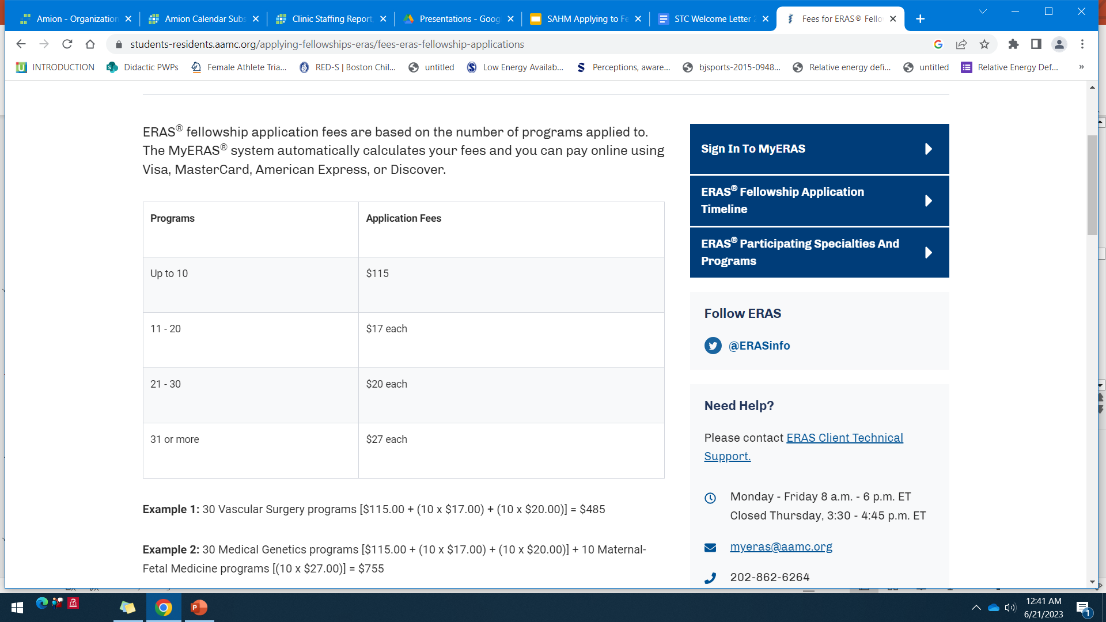
$165 baseline cost
+
cost per programs

Slide 19
Details of application
  Personal statement
  Curriculum Vitae
  Medical Student Performance Evaluation
  Medical School Transcript
  Letters of Recommendation
  Professional Photograph
Notes:
Begin application process
Medical Student Performance Evaluation (MSPE)- Uploaded by med school
Medical School Transcript- Uploaded by med school
Letters of Recommendation (LoRs)- Min 3, Max 4
Photographs- Review specifications, there is a size limit

Slide 20
Personal Statement
Personal & honest
https://medicine.yale.edu/news-article/personal-statement-donts-and-dos/
Have it reviewed by others for spelling, grammar and clarity of writing multiple
Can have multiple version and select which programs to send
Notes:
I did not see or use this website when writing my personal statement, but I actually think it has some great tips for fellowship personal statements in general: https://medicine.yale.edu/news-article/personal-statement-donts-and-dos/

Slide 21
Curriculum Vitae
Includes activities, presentations, publications, research
Limit of 10 “experiences” (research activities, leadership, volunteering, jobs, etc)
But UNlimted Publications and oral Presentations
  include your residency presentations--- morning report, journal club, M&M etc
Research- consider your residency QI project
Notes:
Includes activities, Presentations, publications
Tip: Include your group residency presentations! Morning report, journal club etc.
I don’t think you have to have a limit to your activities, but they definitely should actually address your main areas of interest (and not go back too far – no one cares about what you did in college anymore). You don’t want things you are very passionate about to get lost just because you wanted to look super busy on your CV.

Slide 22
Letters of recommendation
Look at Specific Program Individual requirements
  Ex: Department Chair required?
One from your residency Program Director
Ask them early!
Provide your letter writers your Personal Statement and CV
Notes:
Letters of recommendation
One should be from your program director
Look at specific program individual requirement (chair letter vs no chair letter)
Ask early and provide your PS and CV to writers

Slide 23
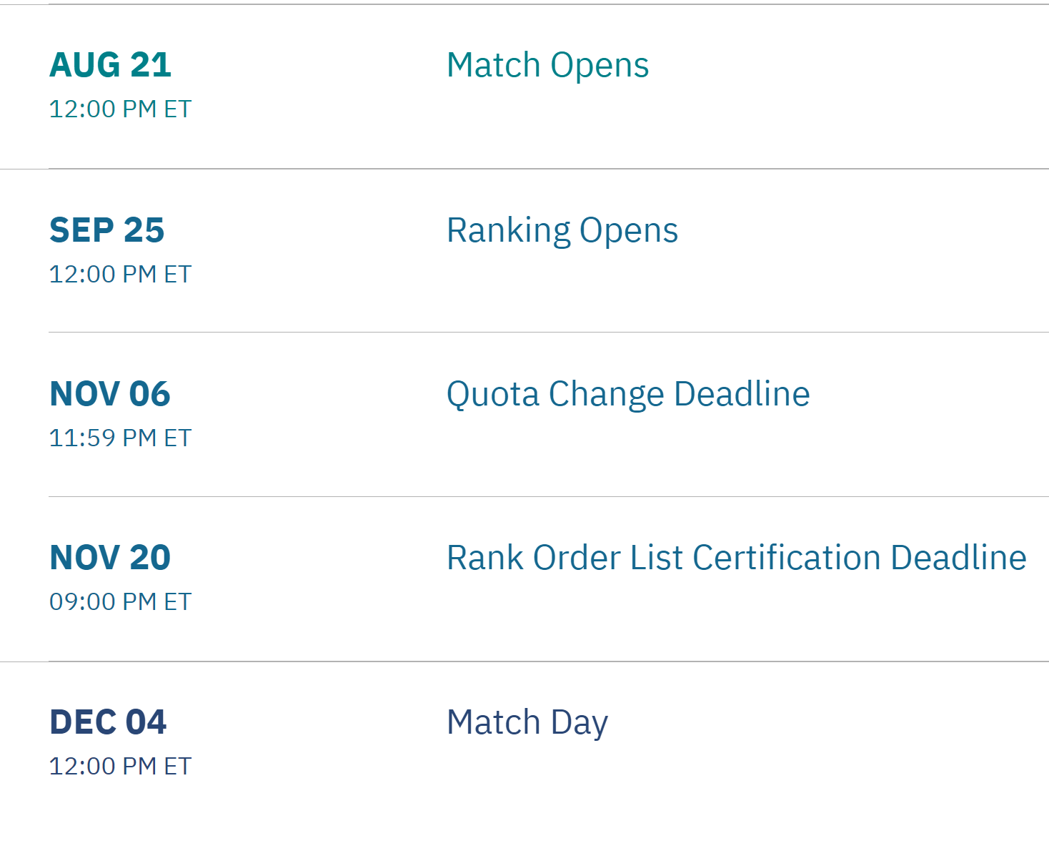
NRMP 2024-2025 Match Timeline
https://www.nrmp.org/fellowship/medicine-and-pediatric-specialties-match/
Notes:
And if you have not matched, there is still an opportunity for you to explore programs who have unfilled position so become familiar with this process before the match day.

Slide 24
STEP 4: Virtual Interviews
Plan for time off early in academic year
Respond timely to interview invites to secure desirable dates
Pre-interview preparation
Professional attire and conduct
Feel free to ask legitimate post-interview follow up questions
Notes:
Have a readily accessible list of programs and date to prevent double booking interview slots
Your response to the interview offer (including how quickly you respond) gives some insight about your professional conduct so please be mindful of this
Proper prior planning prevent poor performance; so before an interview do your research (actually, before you apply!)
Review websites and brochures provided by the programs. Know the faculty, the program strength and areas of focus.
If you get an itinerary, look up the people you are interviewing and take notes so you know who they are.
Understand the roles of the people you are interviewing with. Who runs the program? Who is on the Clinical Competency Committee? How are SOC members decided upon? Who might you be working with for clinical training? Who might you be working with for scholarly work?
Think about what type of questions are appropriate for different roles (e.g. division director, program director, clinical faculty, research faculty can address different types of questions or the same question from different perspectives)
What changes do you expect the program to experience in the next 4 years? (ask the program director and division director)
Feel free to ask legitimate post-interview follow up questions and always get clarification regarding any perceived negative feedback about a program.

Slide 25
STEP 5: The Rank List
(Nov 20th 9 PM EST)
Certify and submit Rank List BEFORE deadline
You can always change ranking until the final day of submission
Notes:
If you have not sign up in NRMP then programs are not able to

Slide 26
Summary: Application Submission Process
Purchase ERAS® Token (June 6th 2024)
Register on MyERAS and begin working on your application (June 2024)
Apply to programs (July 3rd 2024)
Program begin receiving applications (JULY 17th 2024)
Programs begin sending out interview invitations (August-onward)
Virtual Interview season
Rank List Submission (Do it BEFORE the deadline November 20th)
MATCH DAY (Dec 4th)
Notes:
- Have an reality accessible list of programs and date to prevent double booking interview slots
- Your response to the interview offer gives some insight about your professional conduct so please be mindful of this

Slide 27
What Happens If You don’t Match?
DO NOT PANIC!
You can an access the List of Unfilled Programs in the R3® system
Notes:
And programs want to fill so will likely reach out too if they know you haven’t matched!

Slide 28
Contact us
SAHM Student/Trainee Council
Chairperson: Marian Catalan, DO 12mcatalan@gmail.com
SAHM Board of Directors Liaison: Colbey Ricklefs, MD (Colbeyricklefsmd@gmail.com)
Communications: 2 Positions Open (applicants welcome!)
Student/Trainee Outreach:
Janis Sethness, MD, MPH (Janis.sethness@seattlechildrens.org)
Windy Grant MD (grantw1@chop.edu)
Regional Chapter Liaison:
Jennifer Schanzle DO (jennyschanzle@gmail.com)

Slide 29


